Slide 1

Term Deposit Subscription Marketing Campaign
Sarik Koirala | Kalbe Abbas | Rupom Bhattacherjee

Slide 2



Our team
Kalbe Abbas Agharia
Rupom Bhattacherjee
Sarik
Koirala

Slide 3
PROBLEM OVERVIEW

Slide 4

Problem Overview
A bank is conducting a direct marketing campaign through telephones
The purpose of the campaign is to sign up potential customers for a term deposit
This study aims to forecast whether a customer will signup or not for a term deposit

Slide 5
DESCRIPTIVE ANALYTICS

Slide 6
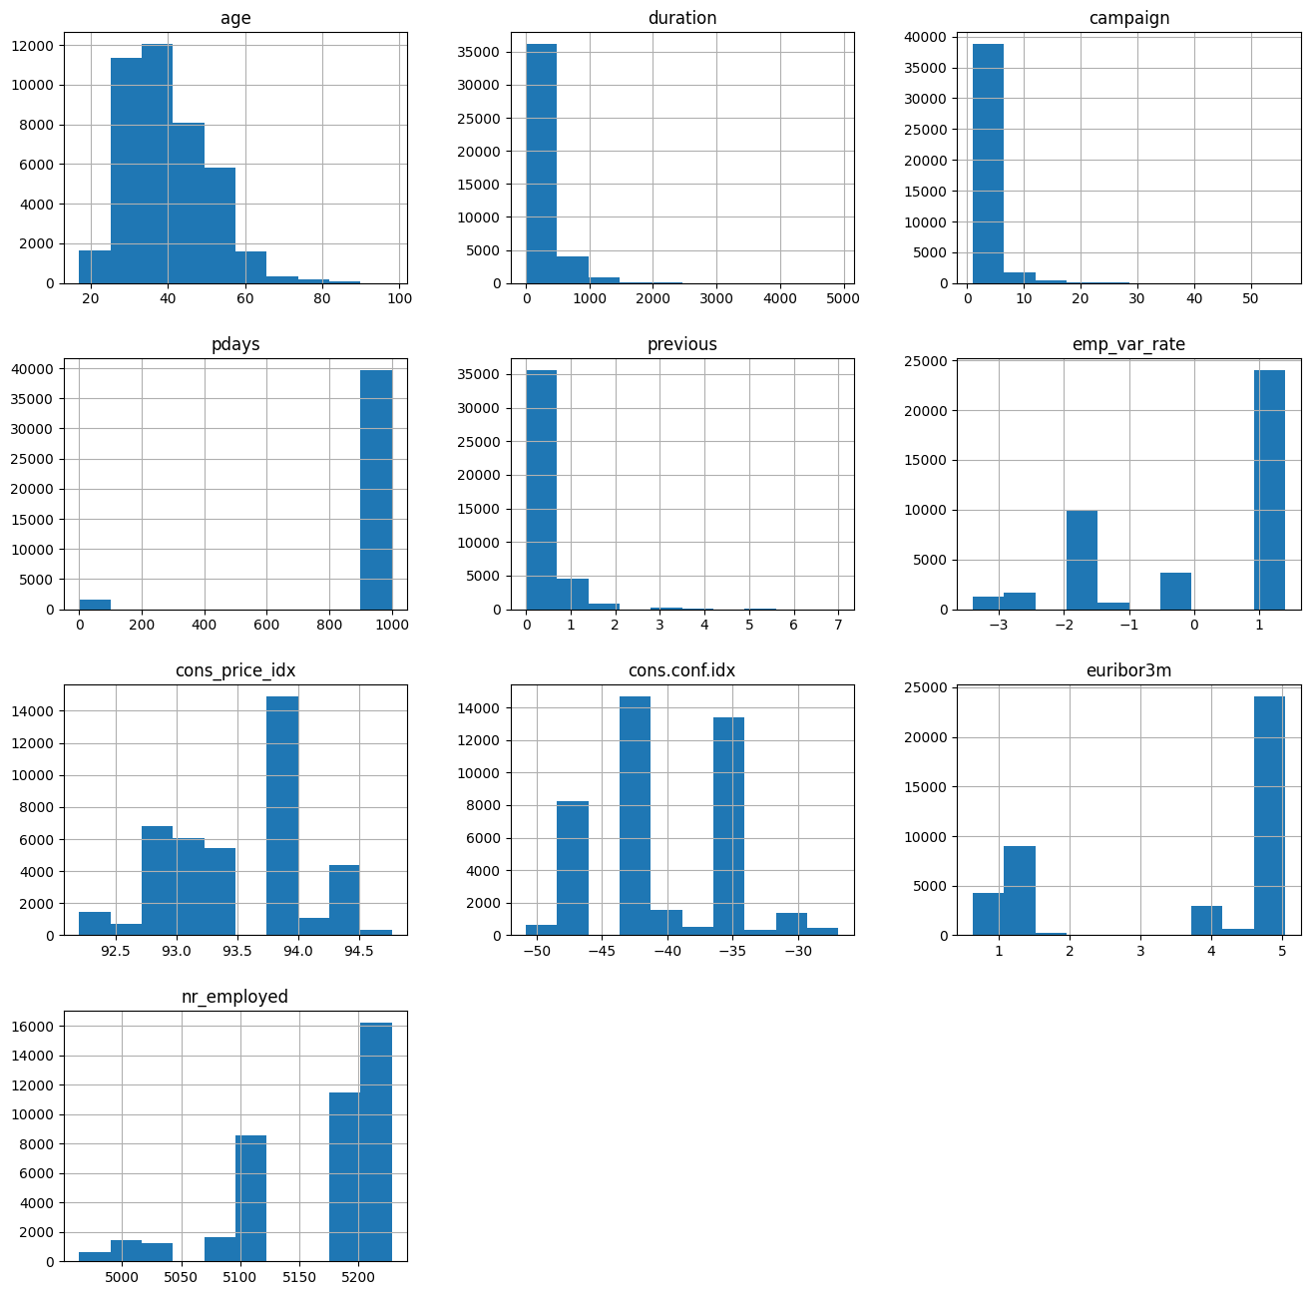
Continuous Features
Inferences:
The features are highly skewed. Hence, we need to perform scaling on all these data points
From the Pdays and Previous univariate distribution we can see that most of the clients in the dataset haven't been contacted in the current and previous campaigns
Duration of the call is right skewed, with most calls ending early
We did not find any null values
Notes:
age , duration, campaign, pdays, previous, emp.var.rate cons.price.idx, cons.conf.idx, euribor3m, nr.employed

Slide 7
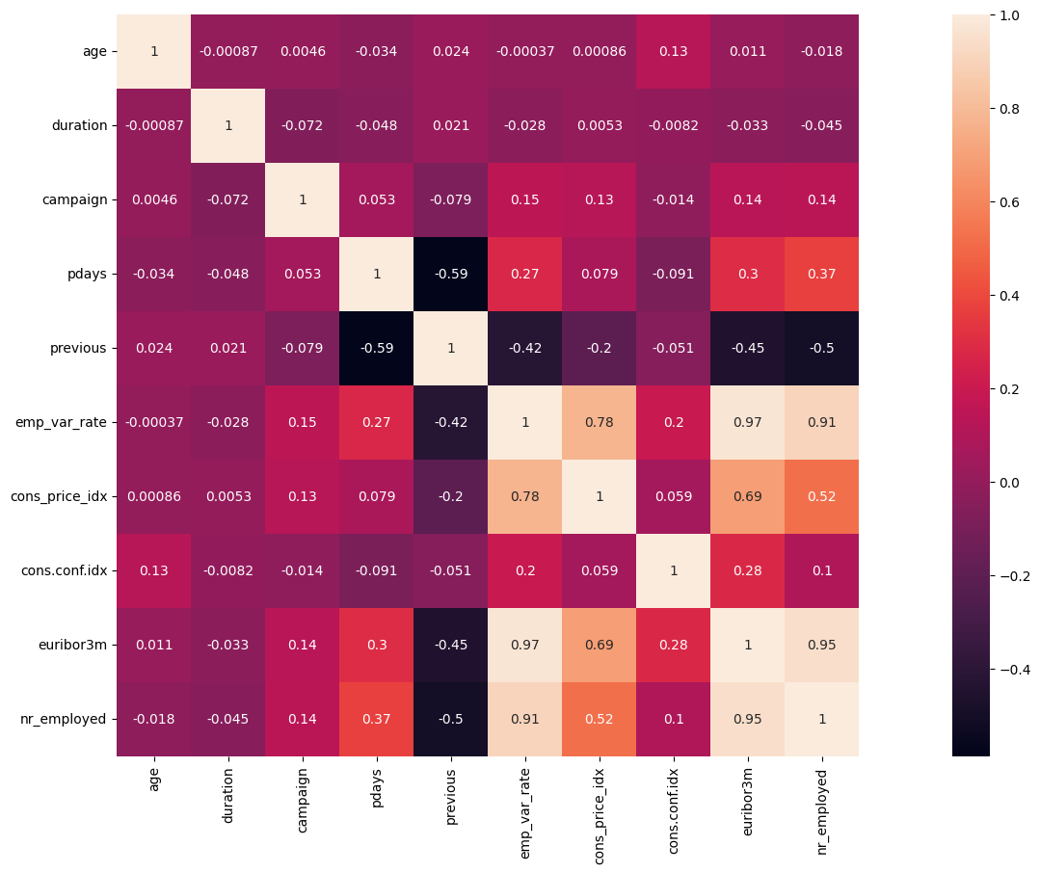
Correlation Matrix for Continuous Features
High correlation between 4 columns based on the Heat Map Method
We will conduct PCA to combat the multicollinearity
cons.price.idx
Euribor3m
nr.employed
emp.var.rate

Slide 8
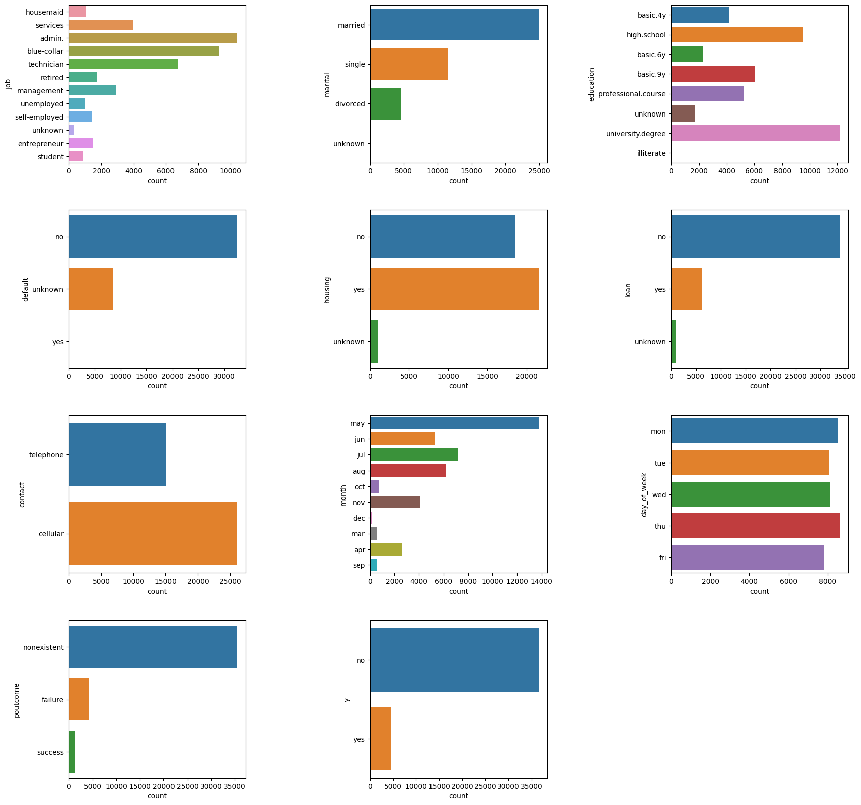
Categorical Features
'job', 'marital', 'education', 'default', 'housing', 'loan’ 'contact', 'month', 'day_of_week', 'poutcome',
Unknown values for few categorical variables.
We kept the unknown values as they are.
These information is not known during a call is performed.

Slide 9
DATA PREPROCESSING

Slide 10
Data Transformation
String Labeling
One-Hot Encoding
Vector Assembler
All categorical variables
Job
Marital
Education
Default
Housing
Loan
Contact
Month
Day_of_week
Poutcome
Only for output variable
Target function
All continuous variables
Age
Duration
Campaign
Pdays
Previous
Emp.var.rate
Cons.price.idx
Euribor3m
Nr.employed
Notes:
We applied One Hot Encoding method to categorical data with using string indexing. One hot encoding is a process by which categorical variables are converted into matrix form with 1 and 0 values.
Data Normalization
We normalized our numerical data using standard scaler function of PySpark. The goal of normalization is to change the values of numeric columns in the data set to use a common scale, without distorting differences in the ranges of values or losing information.
String indexing, one hot encoding, vector assembling, and data normalization are done using a pipeline in PySpark. Before normalizing, the dataset is split in train and test set (80/20) and then normalization is done on training data and transformed in test data.

Slide 11
Data Transformation
String Labeling
Data Normalization
One-Hot Encoding
Vector Assembler
All categorical variables
Job
Marital
Education
Default
Housing
Loan
Contact
Month
Day_of_week
Poutcome
Only for output variable
Target function
All features
Continuous features
StandardScaler
Notes:
We applied One Hot Encoding method to categorical data with using string indexing. One hot encoding is a process by which categorical variables are converted into matrix form with 1 and 0 values.
Data Normalization
We normalized our numerical data using standard scaler function of PySpark. The goal of normalization is to change the values of numeric columns in the data set to use a common scale, without distorting differences in the ranges of values or losing information.
String indexing, one hot encoding, vector assembling, and data normalization are done using a pipeline in PySpark. Before normalizing, the dataset is split in train and test set (80/20) and then normalization is done on training data and transformed in test data.

Slide 12
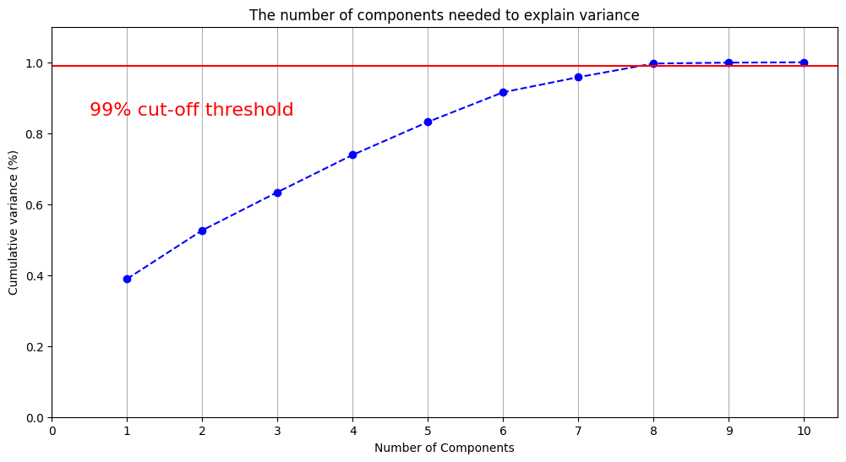
Principal Component Analysis
PCA was applied on numerical features to remove the multicollinearity between the features.
99% covariance was used as threshold to find optimal number of components
Notes:
From our descriptive study we found a high correlation between 4 columns based on the Heat Map Method. These columns are cons.price.idx, euribor3m, nr.employed,emp.var.rate. Therefore we applied PCA on the numerical columns with 99% covariance to remove the multicolinearity between them.

Slide 13
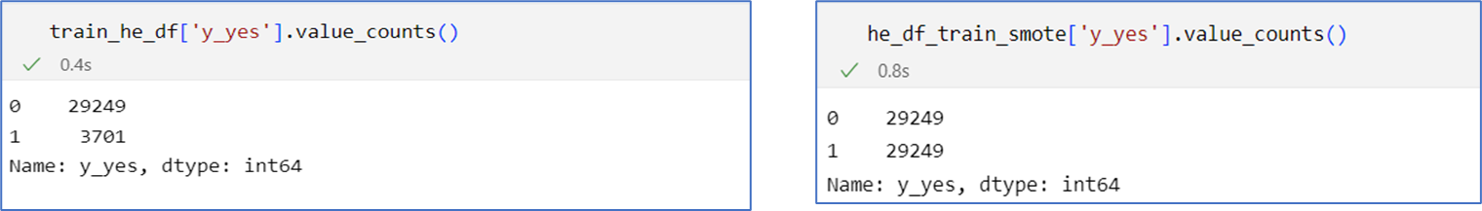
Data Balancing
Dataset is unbalanced regarding the target variable
We oversampled the training data using SMOTE module from python imblearn library
Before
After
Notes:
The dataset is also unbalanced regarding the target variable (36,548 y_no vs 4640 y_yes).
So we oversampled the trainingdata using smote module from python imblearn library.
In oversampling, for every observation in the majority class, we randomly select an observation from the minority class with replacement.
The end result is the same number of observations from the minority and majority classes. The notebook for PCA and SMOTE analysis can be found here. The following figure shows the distribution of target variable in the training set before and after oversampling.

Slide 14
RESULTS & MODEL COMPARISION

Slide 15
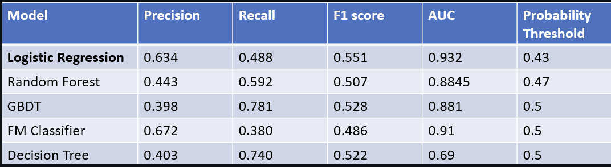
Model Comparison
Logistic Regression was our best performing model (Based on F-1 Score and AUC)

Slide 16
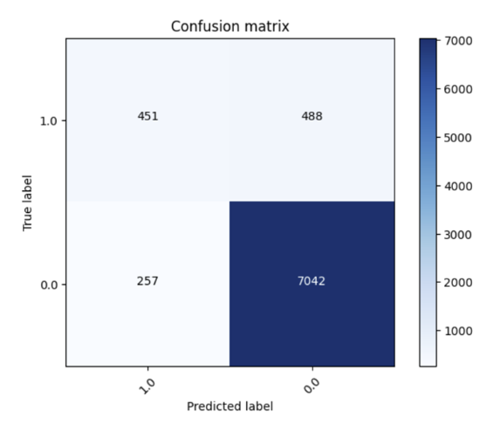
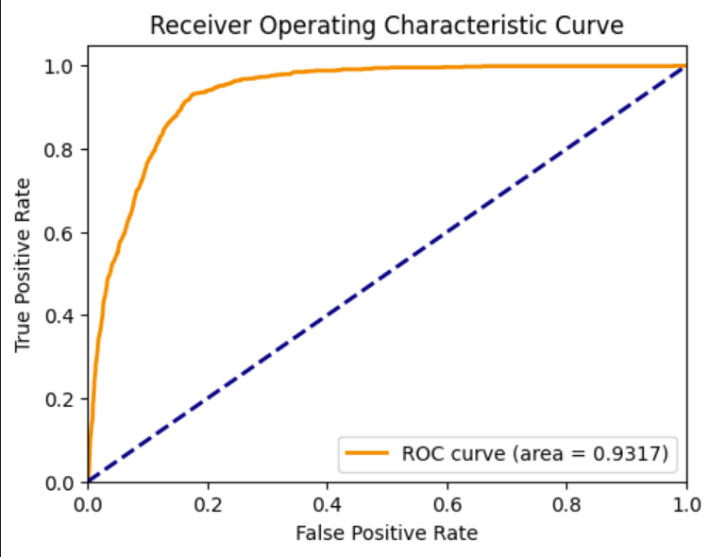
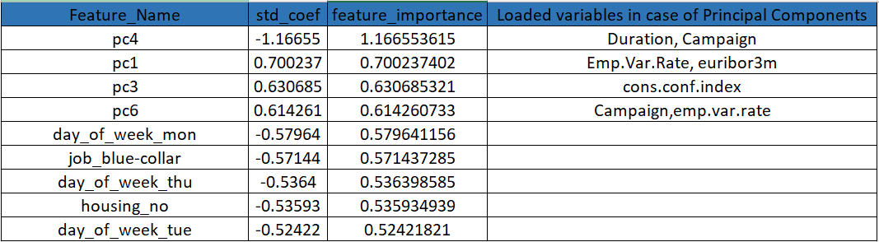
Results
Logistic Regression outperforms much more complex models in this scenario
This not only helps in accuracy but also increases the interpretability of our results.
The optimum probability threshold for best F1 score is 0.43
The most important features from this model stem from: Duration, Campaign, EuriBo3m, Cons. Conf. Index.

Slide 17
Prescriptive Recommendations
Our study recommends an 8-point strategy to the bank’s marketing/sales team for more effective Lead Generation
First time reach-outs are highly effective: Assign high performing sales/marketing employees to first time calls
Increase call durations during first time reach-outs: Introduce training programs that improve workforce’s communication skills
Build aggressive strategies during market downturns: When the monthly Consumer Confidence is low, people are more likely to purchase term deals. People in the age bracket 32-38 are prime customers.
Strategize workforce productivity around high lead conversion dates: Lead conversion is higher around the weekends and low on Mondays, Tuesdays and Thursdays.
Profile customers based on their occupation: White collar workers are more likely to purchase term deals.
Profile customers based on their education level: College degree holders are more likely to purchase term deposits .
Profile customers based on their home ownership status: Individuals who have a housing loan are less likely to purchase term deposits.

Slide 18

Thankyou

